Slide 1

Chapter 10
Interrupts
Updated: 4/19/19

Slide 2
Basic Concepts in Interrupts
□An interrupt is a communication process set up in a microprocessor or microcontroller in which:
An internal or external device requests the MPU to stop the processing
□The MPU acknowledges the request
□Attends to the request
□Goes back to processing where it was interrupted

Slide 3
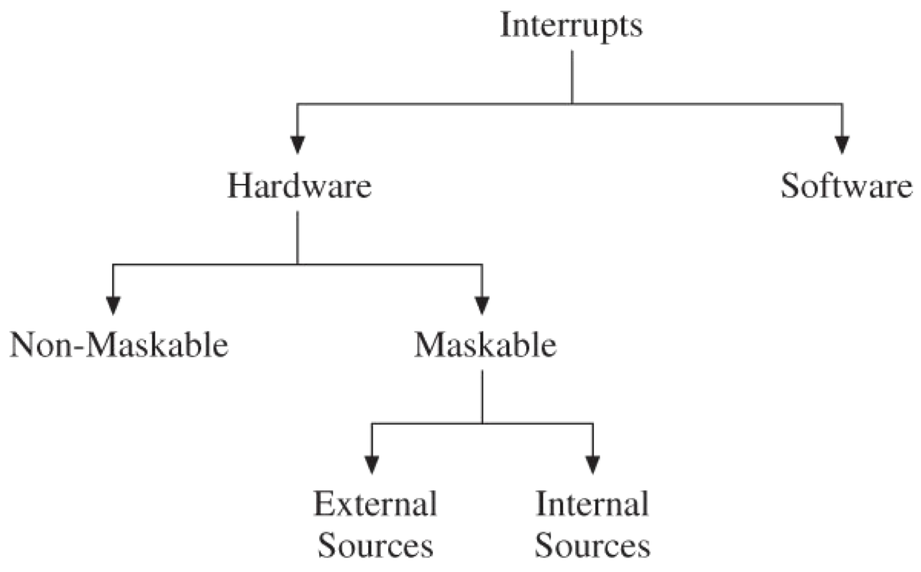
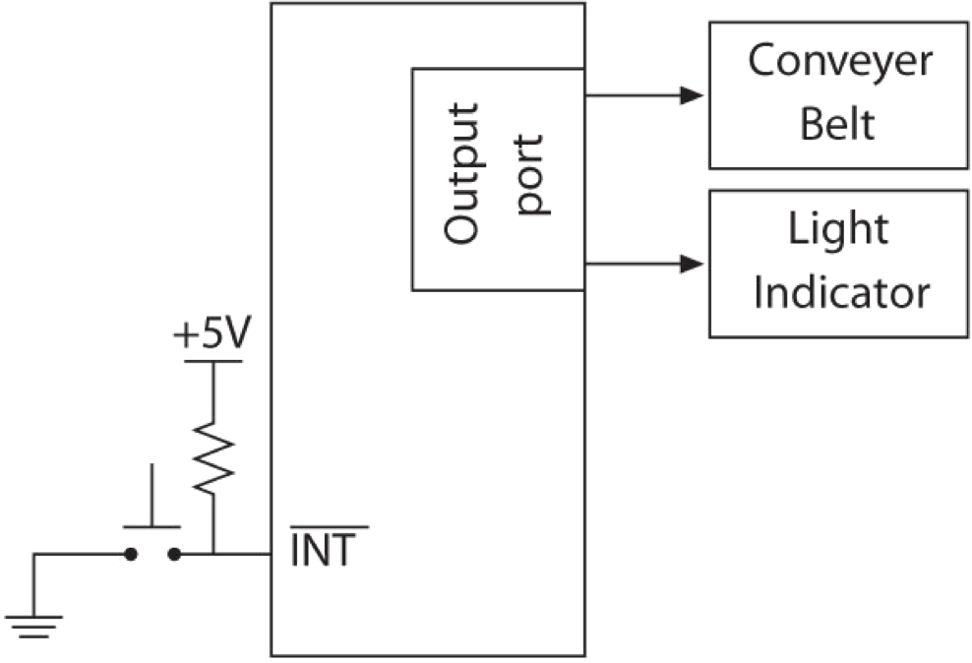
Types of Interrupts
□Hardware interrupts
Maskable: can be masked or disabled
□Two groups: external and internal interrupts
External through designated I/O pins
Internal by Timers, A/D, etc.
Non-maskable: cannot be disabled
□Software interrupts: generally used when the situation requires stop processing and start all over
Examples: divide by zero or stack overflow
Generally, microcontrollers do not include software interrupts

Slide 4
MPU Response to Interrupts (1 of 2)
□When the interrupt process is enabled, the MPU, during execution, checks the interrupt request flag just before the end of each instruction.
□If the interrupt request is present, the MPU:
Completes the execution of the instruction
Resets the interrupt flag
Saves the address of the program counter on the stack
□Some interrupt processes also save contents of MPU registers on the stack.
Stops the execution

Slide 5
MPU Response to Interrupts (2 of 2)
□To restart the execution, the MPU needs to be redirected to the memory location where the interrupt request can be met.
Accomplished by interrupt vectors
□The set of instructions written to meet the request (or to accomplish the task) is called an interrupt service routine (ISR).
□Once the request is accomplished, the MPU should find its way back to the instruction, next memory location where it was interrupted.
Accomplished by a specific return instruction
Main code
….
Setup interrupt vectors
….
HERE: GOTO HERE
ORG 0x100
INT1_ISR: ISR code
….
…. RETFIE
END

Slide 6
Interrupt Service Routine (ISR)
□RETFIE instruction format
RETFIE [s] ;Return from interrupt: s = 0 or 1
□If s =1, the MPU also retrieves the contents of W, BSR, and STATUS register (previously saved) before enabling the global interrupt bit.
Format: RETFIE FAST
□The same as RETFIE 1 except the formats are different
Main code
….
Setup interrupt vectors
….
HERE: GOTO HERE
ORG 0x100
INT1_ISR: ISR code
….
…. RETFIE
END

Slide 7
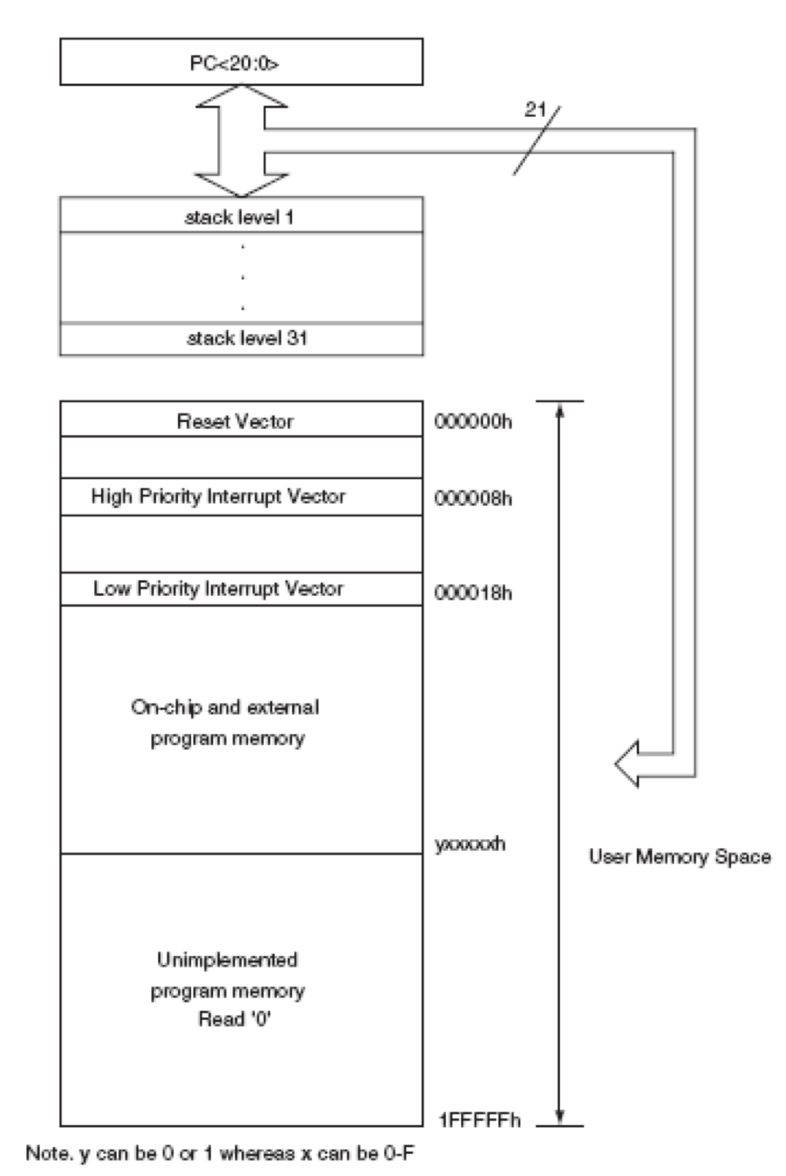
Interrupt Vectors
□Direct the MPU to the location where the interrupt request is accomplished.
□They are:
Defined memory location where a specific memory location/s is assigned to the interrupt request
Defined vector location where specific memory locations assigned to store the vector addresses of the ISRs
Specified by external hardware: The interrupt vector address (or a part of it) is provided through external hardware using an interrupt acknowledge signal.

Slide 8
Interrupt Service Routine (ISR)
□A group of instructions that accomplishes the task requested by the interrupting source
□Similar to a subroutine except that the ISR must be terminated in a Return instruction specially designed for interrupts
The Return instruction, when executed, finds the return address on the stack and redirects the program execution where the program was interrupted.
Some Return instructions are designed to retrieve the contents of MPU registers if saved as a part of the interrupts.
→RETFIE FAST (1/0)

Slide 9
Interrupt Priorities
□Rationale for priorities
Multiple interrupt sources exist in a system, and more than one interrupt requests can arrive simultaneously.
□Example: A/D and Timer0
When one request is being served (meaning when the MPU is executing an ISR), another request can arrive.
→ the interrupt requests must be prioritized.
Most MCUs (and MPUs) include an interrupt priority scheme. Some are based on hardware and some use software.
IIN1
INT1_ISR
IN
T2
IIN1
INT1_ISR
INT2
INT1 has higher priority than INT2

Slide 10
Reset as a Special Purpose Interrupt
□Reset is an external signal that enables the processor to begin execution or interrupts the processor if the processor is executing instructions.
□There are at least two types of resets in microcontroller- based systems.
Power-on reset and manual reset
□When the reset signal is activated, it establishes or reestablishes the initial conditions of the processor and directs the processor to a specific starting memory location.

Slide 11
PIC18 Interrupts
□PIC18 Microcontroller family
Has multiple sources that can send interrupt requests
□Does not have any non-maskable or software interrupts; all interrupts are maskable (can be disabled)
Has a priority scheme divided into two groups
□High priority and low priority
Uses many Special Function Registers (SFRs) to implement the interrupt process

Slide 12
PIC18 Interrupt Sources
Divided into two groups
External sources and internal peripheral sources on the MCU chip
External sources
Three pins of PORTB -RB0/INTO, RB1/INT1,and RB2/INT2 (edge driven)
Change in logic levels of pins RB4-RB7 of PORTB can be recognized as interrupts
Internal sources
Use SFRs to setup the interrupt process….

Slide 13
PIC18 Interrupt Sources
□Internal peripheral sources
Examples: Timers, A/D Converter, Serial I/O, and Low-Voltage Detection Module
□SFRs
Used to setup the interrupt process:
RCON Register Control (global priority)
INTCON Interrupt Control
INTCON2Interrupt Control2
external interrupt sources
INTCON3 Interrupt Control3
PIR1 and PIR2 Peripheral Interrupt Register1 & 2
PIE1 and PIE2 Peripheral Interrupt Enable 1 & 2
IPR1 and IPR2 Interrupt Priority Register 1 & 2
Handle Internal peripherals
Click here: Summery of Interrupt Registers

Slide 14
PIC18 Interrupt Sources
□To recognize the occurrence of an interrupt request, the MPU needs to check the following three bits:
The flag bit to indicate that an interrupt request is present
The enable bit to redirect the program execution to the interrupt vector address
The priority bit (if set) to select priority

Slide 15
PIC18 Interrupt Sources
□In PIC interrupt are controlled by three bits in three different registers.
The IE bit is the interrupt enable bit used to enable the interrupt.
The IP bit is the interrupt priority bit which selects the priority (high or low).
The IF bit is the interrupt flag that indicates the interrupt has occurs. This bit must be cleared in the interrupt service function or no future interrupt will ever take effect.

Slide 16
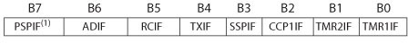
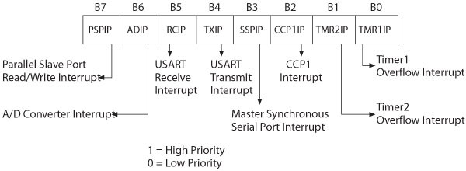
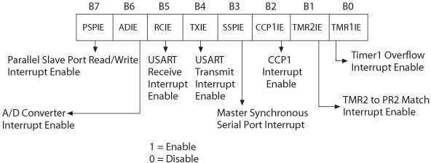
PIR (flag)
IPR (priority) 1=High Prio 0=Low Prio
PIE (peripheral) 1=Enable 0=Disable

Slide 17
Interrupt Priorities and RCON Register (1 of 2)
□Any interrupt can be set up as high- priority or low-priority.
All high-priority interrupts are directed to the interrupt vector location 000008H.
All low-priority interrupts are directed to the interrupt vector location 000018H.
A high-priority interrupt can interrupt a low-priority interrupt in progress.

Slide 18
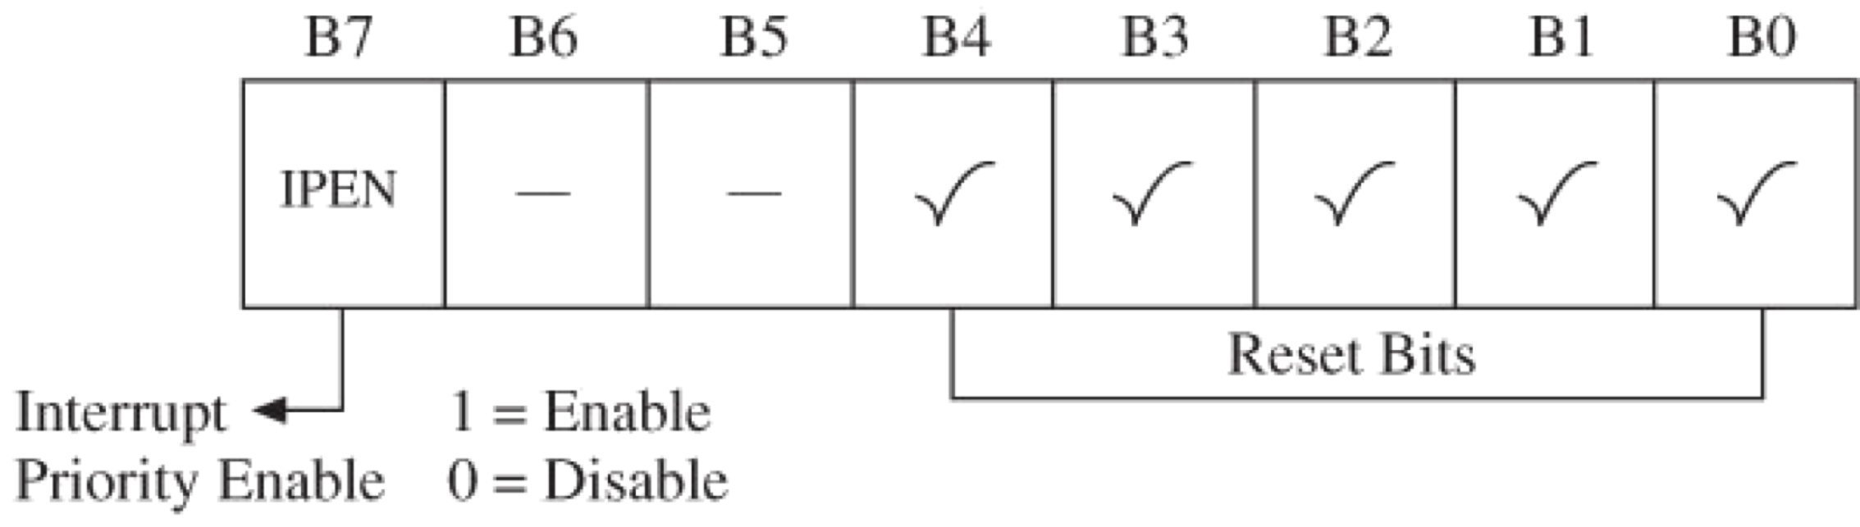
Interrupt Priorities and RCON Register (2 of 2)
□The interrupt priority feature is enabled by Bit7 (IPEN) in RCON register.

Slide 19
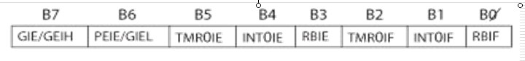
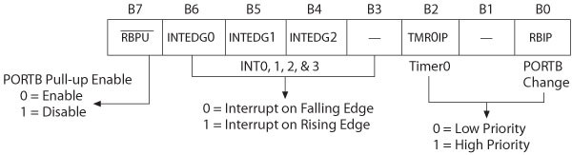
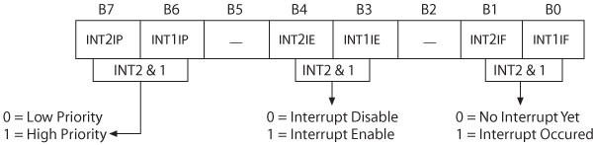
External Interrupts and INTCON Registers (1 of 3)
□Three registers with interrupt bit specifications primarily for external interrupt sources. INTCON (3)

Slide 20
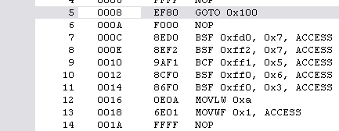
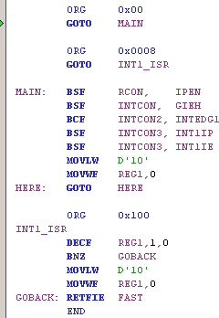
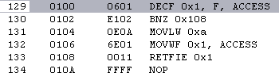
Example
□Write an instruction to setup INT1 as the high priority interrupt. (INT1 → RB1)
High Priority Interrupt Vector:
ISR:

Slide 21
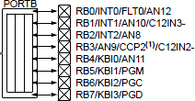
Example
INTCON
INTCON2
□Software Setting
INTCON3
If ZERO no priority (early versions)
If enabled → high priority → gates all H/L interrupts to the CPU (remember: GIEL enables all low-priorities Interrupts to the CPU
If 1 → rising edge (RB1) If 1 → High Priority
If 1 → INT1 enabled
When INT1 goes from high to low value of REG1 decrements!
NOTE: INTCON3: FLAG bit is read only!
Convert to C code!

Slide 22
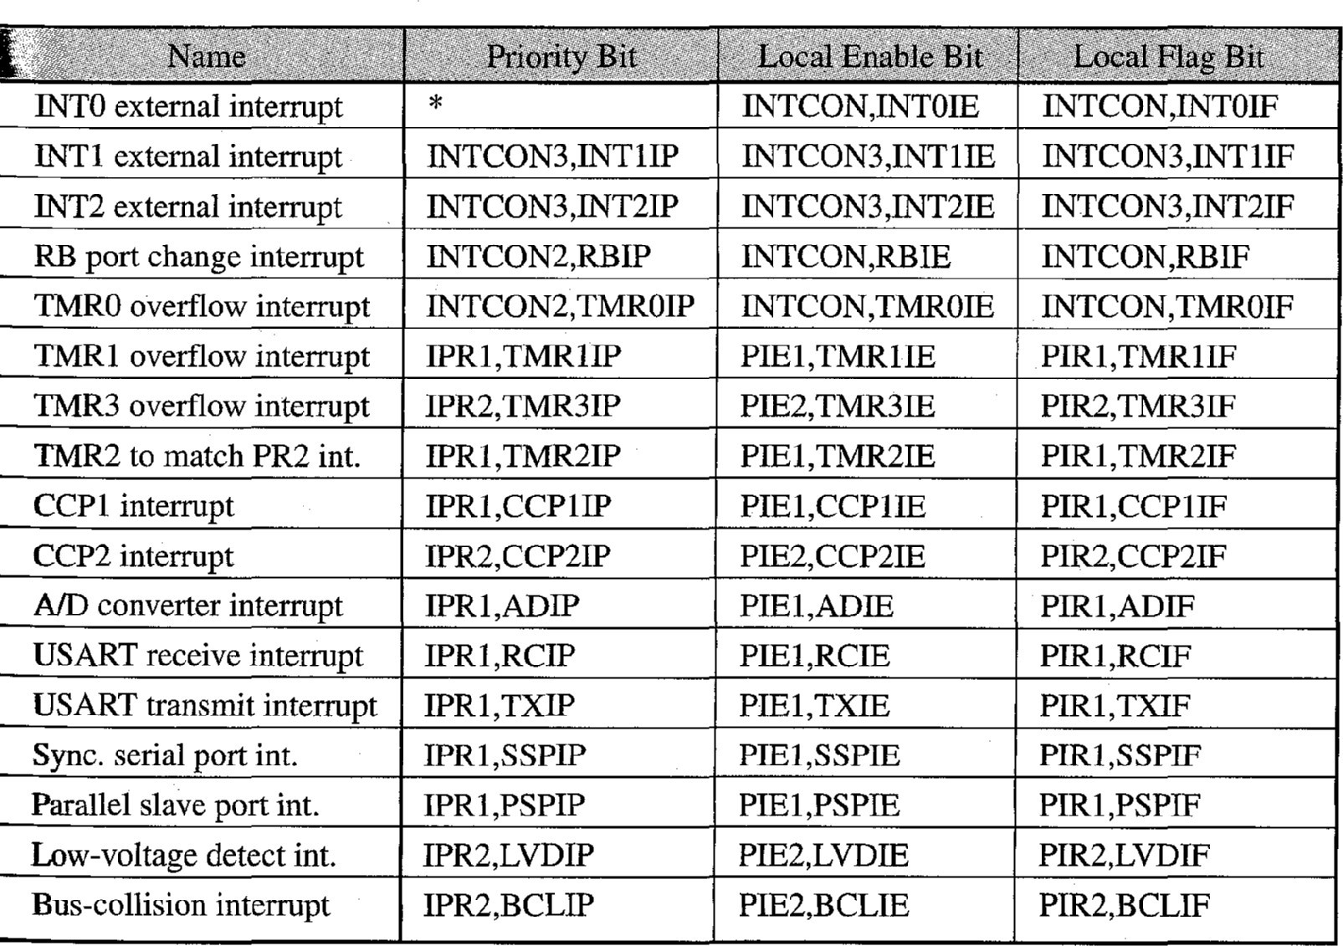
Interrupt Setting (INT0 high priority only)

Slide 23
C Code Example
When a pulse is generated on INT0 the high priority interrupt is generated!
ADCON1 = 0x0F;
// make ports pins digital
TRISB = 1;
// make RB0 input
RCONbits.IPEN = 1;
// IPEN = 1
INTCON2bits.INTEDG0 = 0;
INTCONbits.INT0IE = 1;
INTCONbits.GIEH = 1;
// make INT0 negative edge triggered
// enable INT0
// enable high priority interrupts
// INT0 is now armed and active

Slide 24
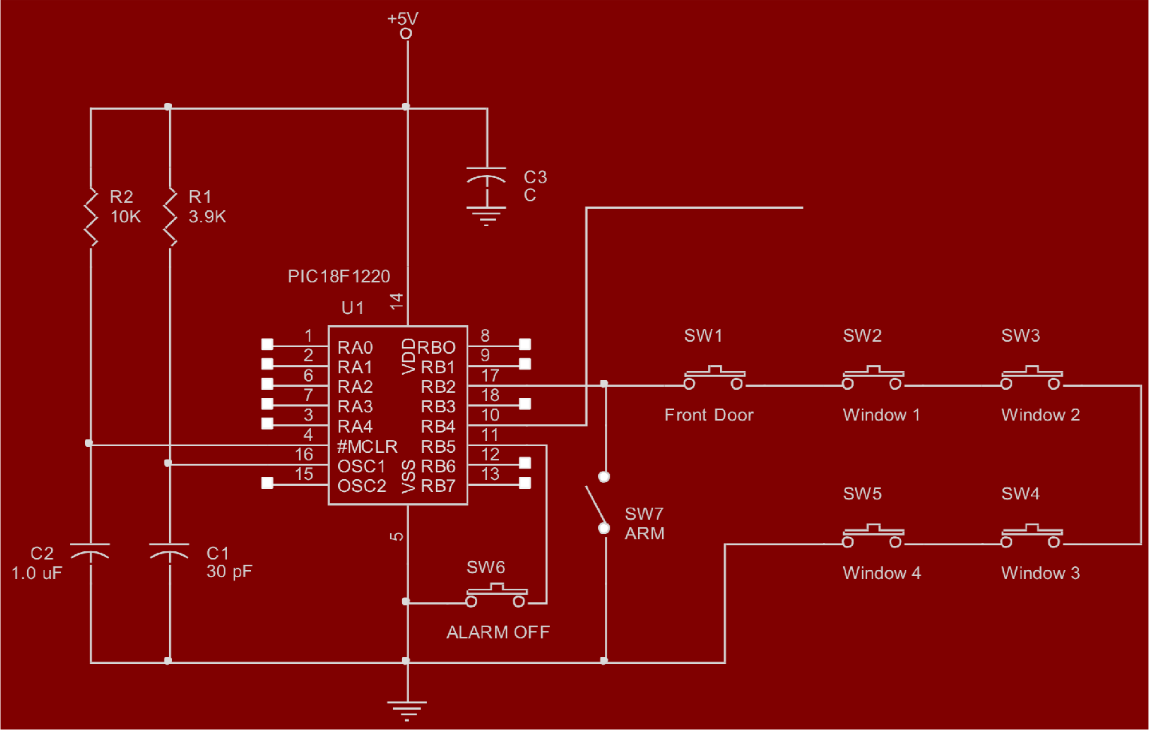

C Code Example – Burglar Alarm Circuit

Slide 25
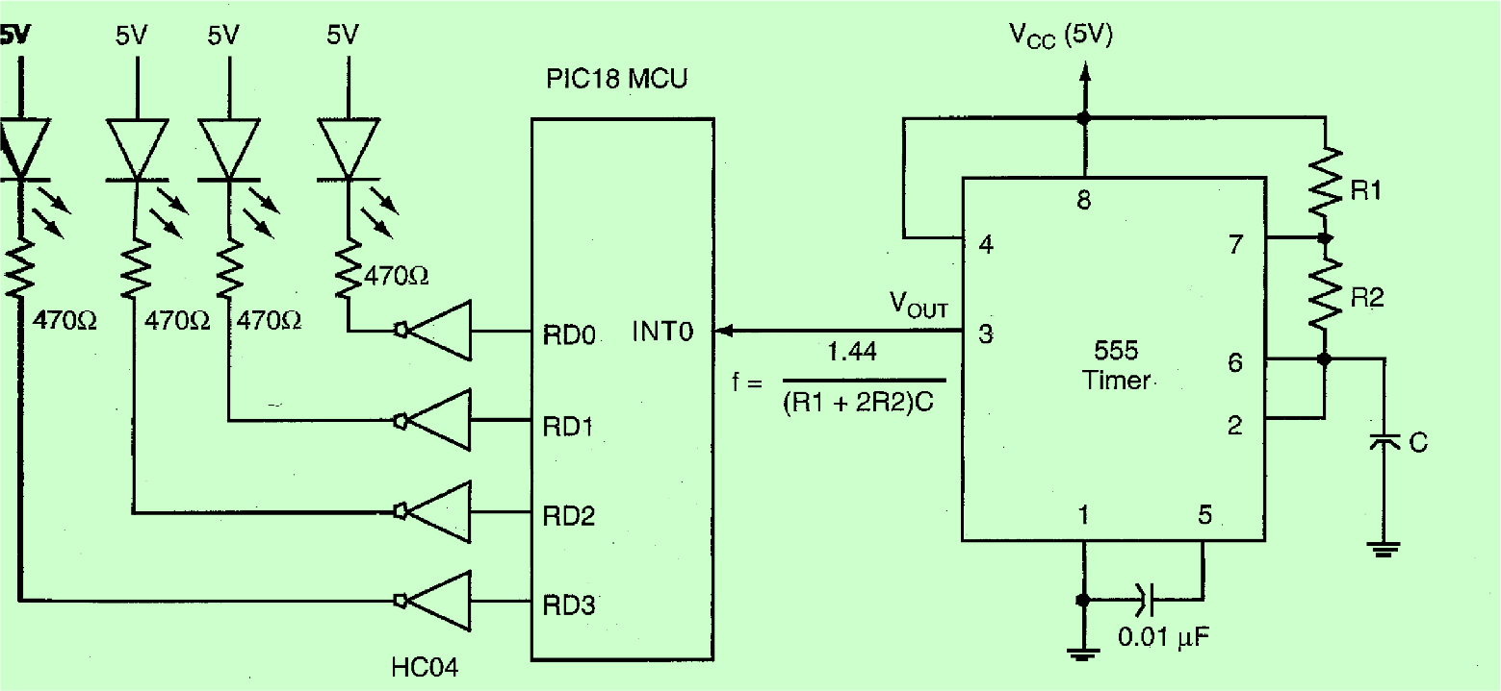
Another practical Example
Suppose you are given a circuit as shown below. Write a main program and an INT0 interrupt service routine in assembly language. The main program initializes a counter to 0,
enables the INTO interrupt, and then stays in a while-loop to wait forever. The INT0 interrupts service routine simply increments the counter by 1 and outputs it to the LEDs. Whenever
is incremented to 15, the service routine resets it to 0. Choose appropriate component that the PIC1 8 receives an INTO interrupt roughly every second.

Slide 26
Handling Multiple Interrupt Sources
□In PIC18 MCU, all interrupt requests are directed to one of two memory locations:
000008H (high-priority) or 000018 (low-priority)
□When multiple requests are directed to these locations, the interrupt source must be identified by checking the interrupt flag through software instructions.

Slide 27
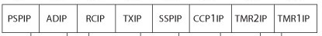
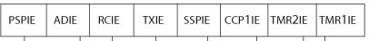
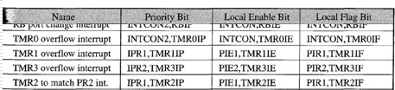
IPR1
Example
PIE1
BSF | INTCON, GIEL | ;Enable global low-priority - INTCON ,6>
BCF | IPR1, TMR1IP | ;Set Timer1 as low-priority
BSF | PIE1, TMR1IE | ;Enable Timer1 overflow interrupt
BCF | IPR1, TMR2IP | ;Set Timer2 as low-priority
BSF | PIE1, TMR2IE | ;Enable Timer2 match interrupt
BCF | PIR1, TMR1IF | ;Clear TMR1 flag
CALL | TMR1L | ;Call service subroutine
BCF | PIR1,TMR2IF | ;Clear TMR2 flag
CALL | TMR2 | ;Call service subroutine

Slide 28
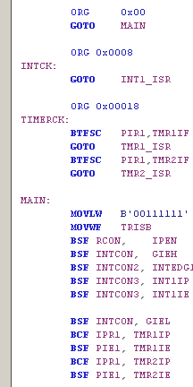
Example of using multiple interrupts
INT1=High Priority / TMR1 and TMR2 Low Priority
Assign the High Priority Interrupt Vector
Assign the Low Priority Interrupt Vector
Setup the interrupt registers for external interrupt
Setup the interrupt registers for internal interrupts
High priority
Low priority Two interrupts Check Flag
INT is enabled Edge driven
INT is enabled Edge driven

Slide 29
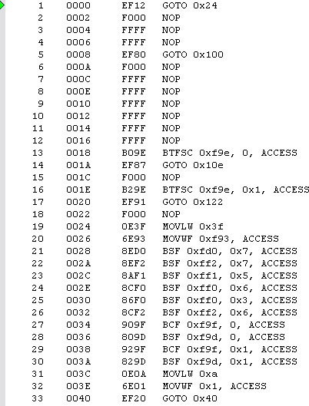
Example of using multiple interrupts
INT1=High Priority / TMR1 and TMR2 Low Priority
High priority
Low priority Two interrupts Check Flag
MA
IN
INT is enabled Edge driven
INT is enabled Edge driven

Slide 30

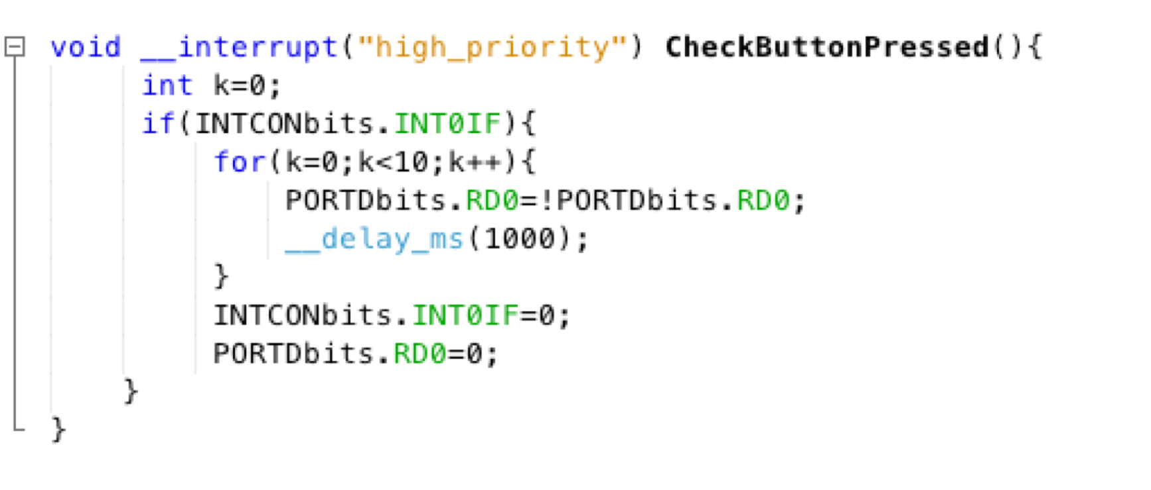

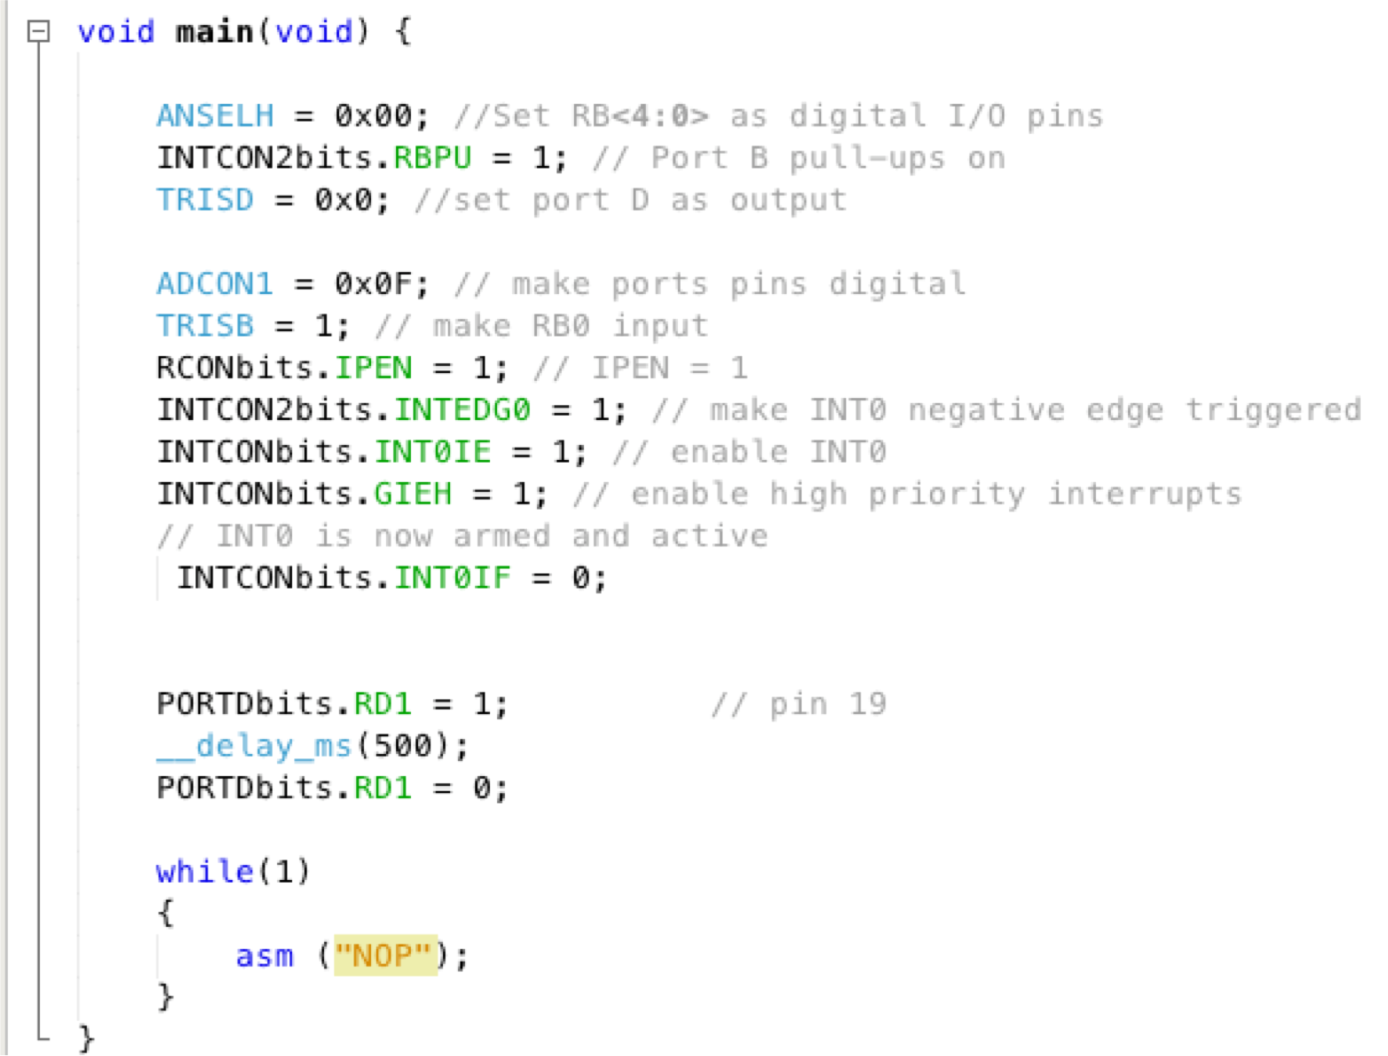
XC8 Interrupt Handling
The ISR can be defined as high_priority or low_priority
This Interrupt Vector is called CheckButtonPressed
The ISR for IV is defined here
With in the Interrupt definition It is important to clear the Interrupt FLAG!

Slide 31
PIC18F2XK20 (28-PIN) BLOCK DIAGRAM

Slide 32
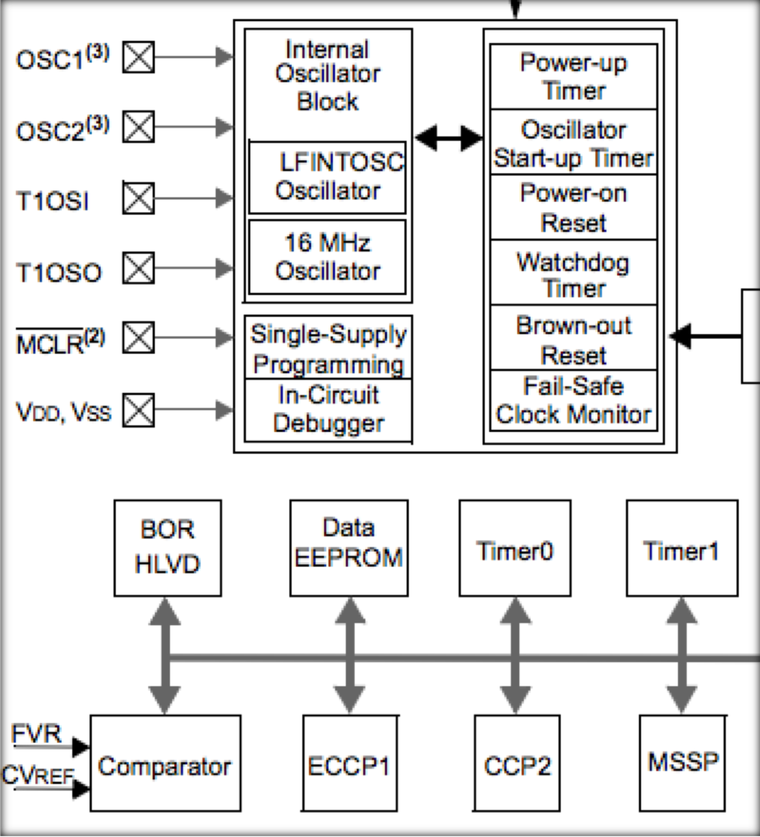
PIC18F2XK 0 (28-PIN) BLOCK DIA RAM
2
G

Slide 33


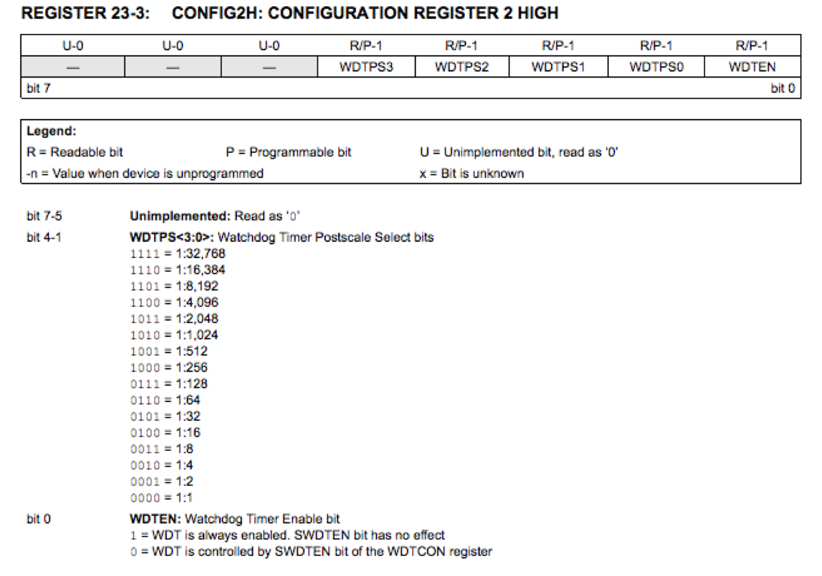

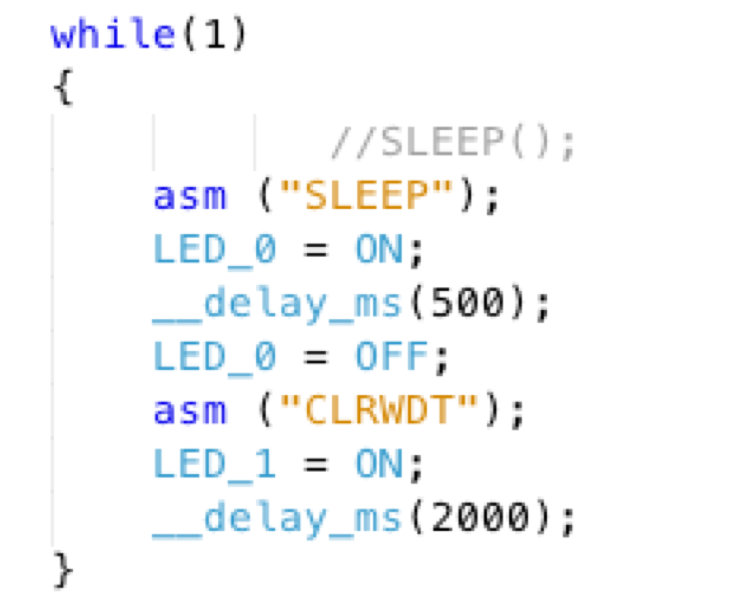

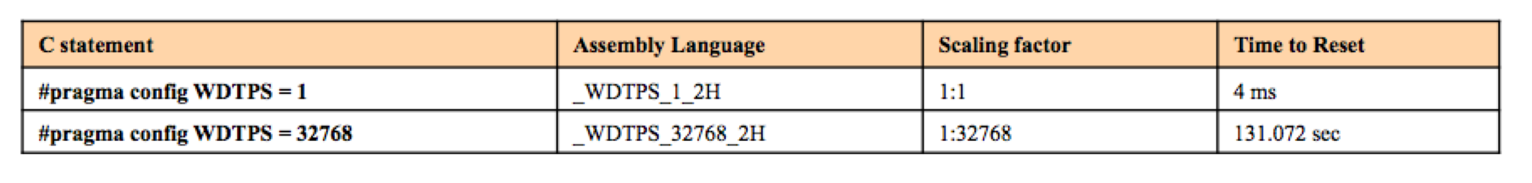
SLEEP and WDT
The SLEEP mode can reduce the power! The CLRWDT is used to reset the WDT Refer to the SPEC sheet.

Slide 34

PIC18 Resets
□When the reset signal is activated:
The MPU goes into a reset state during which the initial conditions are established.
The program counter is cleared to 000000 which is called the reset vector.
The MPU begins the execution of instructions from location 000000.

Slide 35
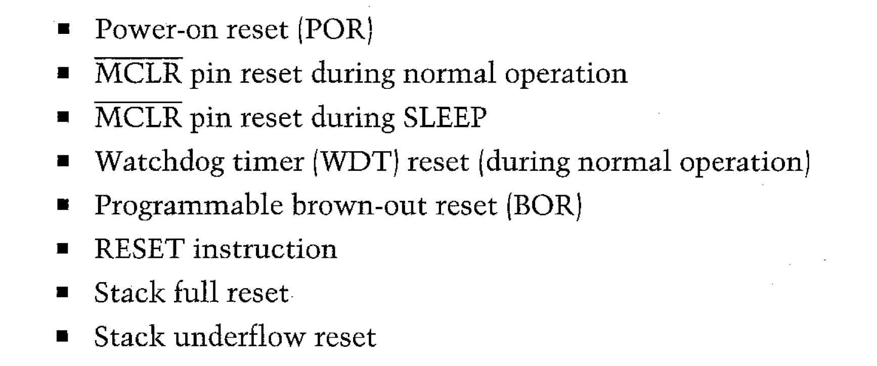
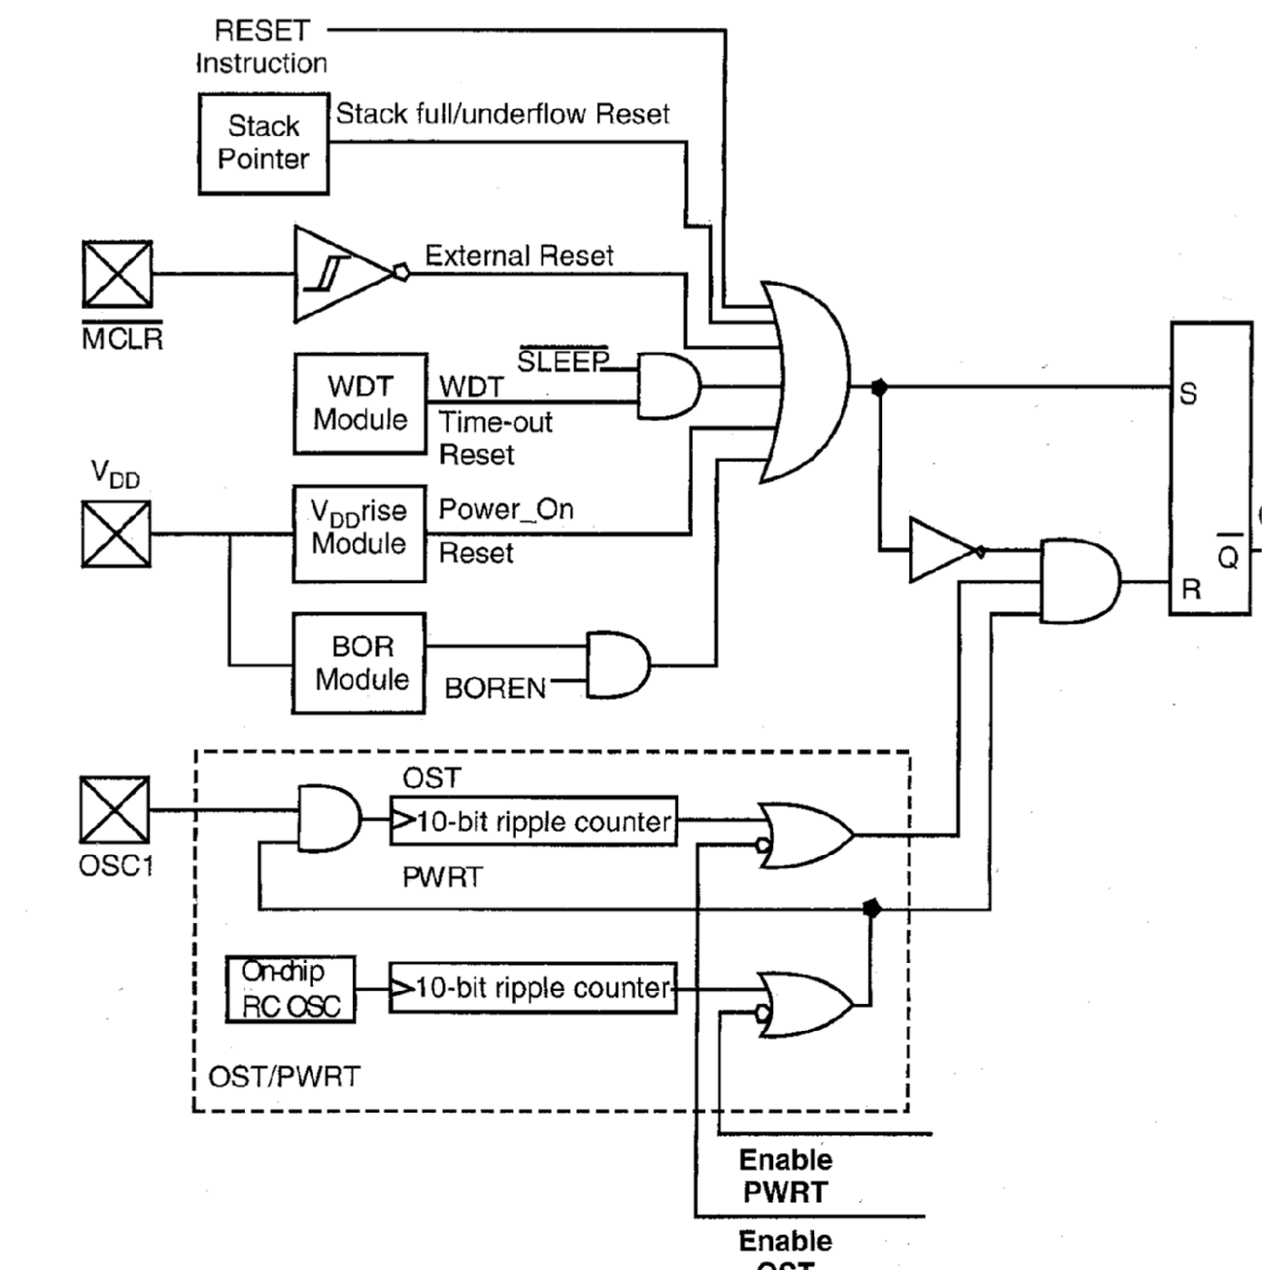
On Chip reset circuit for PIC18
Chip reset

Slide 36
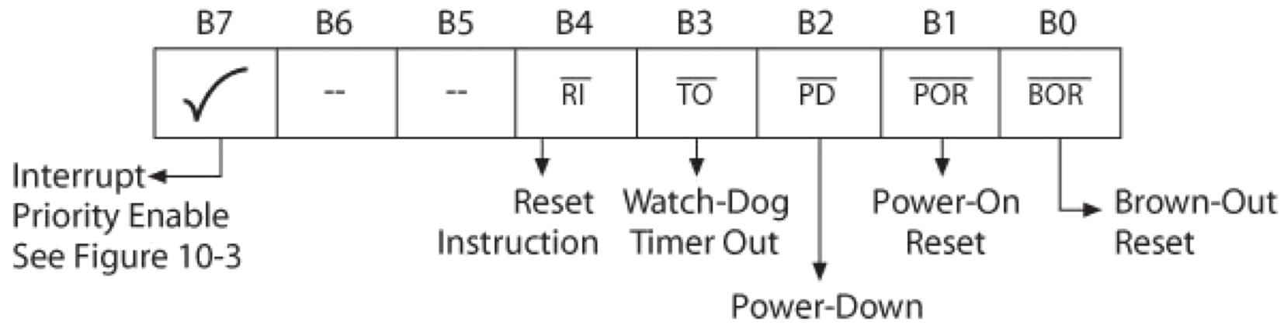
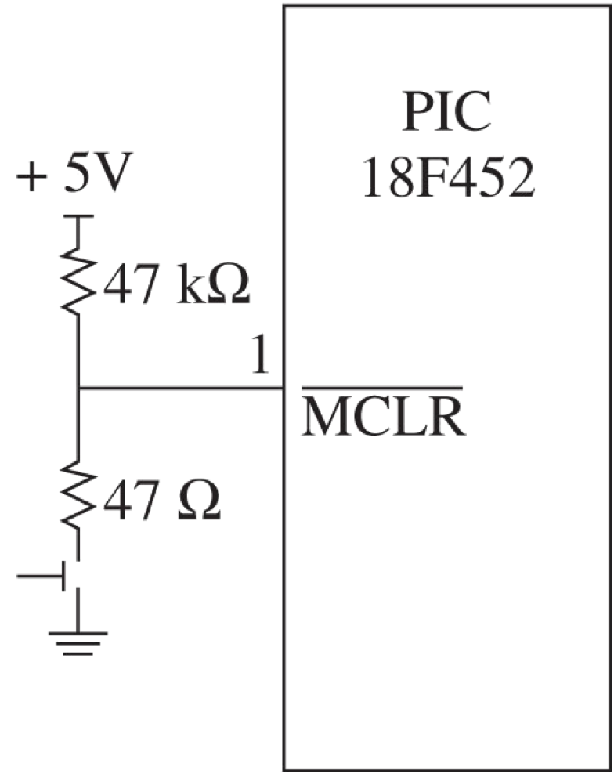
PIC18 Resets
□PIC18 MCU can be reset by external source such as the push-button key, or when power is turned-on, or by various internal sources.
Resets categorized as follows:
□External Manual Reset Key
□Power-on Reset (POR)
□Watchdog Timer Reset (WDT)
□Programmable Brown-Out Reset (BOR)
□RESET and SLEEP Instructions
□Stack Full and Underflow Reset
Find MCLR pin!

Slide 37
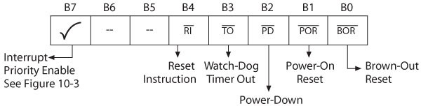
Example of Reset Programming
Identifying a power-on reset
IF_ RCON,NOT_POR == 0 ;POR has occurred
setf RCON ;Reinitialize all reset flags after power on
<take action particular to power—on reset>
ENDIF_
Identifying a reset due to execution of a “reset” instruction
IF_ RCON,NOT_RI == 0
;reset' instruction has been executed
;Set bit to distinguish froe other resets
bsf RCON.NOT_RI
<take appropriate action in response to “reset” instruction>
ENDIF

